Slide 1
IT304 Computer Networks Week 2-Lecture 3-Layering

Slide 2



Design Philosophy of DARPA Internet Protocols
Top level goal: effective technique for multiplexed utilization of existing interconnected networks
The Internet must… (sorted based on importance)
continue despite loss of networks or gateways
support multiple types of communications service
accommodate a variety of networks
permit distributed management of its resources
be cost effective
permit host attachment with a low level of effort
resources used in the internet architecture must be accountable
Notes:
state information which describes the on-going conversation must be protected.

Slide 3
Design Philosophy of DARPA Internet Protocols
Top level goal: effective technique for multiplexed utilization of existing interconnected networks
The Internet must… (sorted based on importance)
continue despite loss of networks or gateways
state information which describes the on-going conversation must be protected
support multiple types of communications service
TCP, UDP
accommodate a variety of networks
including military and commercial facilities
D. Clark. 1988. The design philosophy of the DARPA internet protocols. SIGCOMM Comput. Commun. Rev. 18, 4 (August 1988),
Notes:
state information which describes the on-going conversation must be protected.

Slide 4
Protocol “layers”
Networks are complex,
with many “pieces”:
hosts
routers
links of various media
applications
protocols
hardware, software
Question: is there any hope of organizing structure of network?

Slide 5

Layering of airline functionality
ticket (purchase)
baggage (check)
gates (load)
runway (takeoff)
airplane routing
ticket (complain)
baggage (claim
gates (unload)
runway (land)
airplane routing
ticket
baggage
gate
takeoff/landing
airplane routing
airplane routing
airplane routing
departure
airport
intermediate air-traffic
control centers
arrival
airport
layers: each layer implements a service
via its own internal-layer actions
relying on services provided by layer below

Slide 6
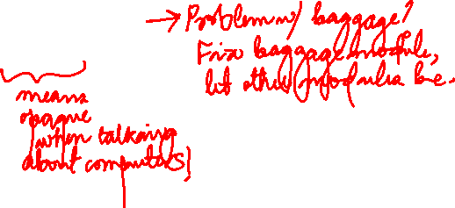
Why layering?
dealing with complex systems:
explicit structure allows identification, relationship of complex system’s pieces
layered reference model for discussion
modularization eases maintenance, updating of system
change of implementation of layer’s service transparent to rest of system

Slide 7
What’s a protocol?
Human protocols:
“what’s the time?”
“I have a question”
introductions
Network protocols:
computers (devices) rather than humans
all communication activity in Internet governed by protocols
Rules for:
… specific messages sent
… specific actions taken when message received, or other events
Protocols define the format, order of messages sent and received among network entities, and actions taken on message transmission, receipt

Slide 8



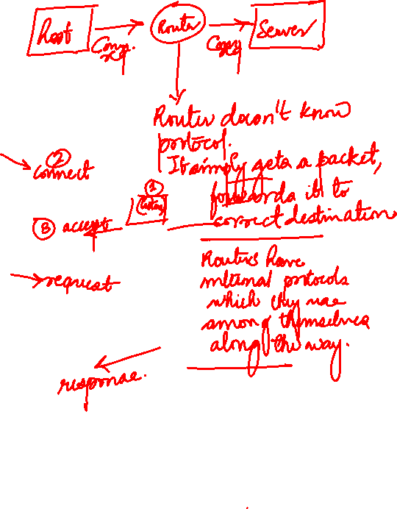
What’s a protocol?
A human protocol and a computer network protocol:
Hi
TCP connection
request
Hi
TCP connection
response
Got the
time?
GET http://gaia.cs.umass.edu/kurose_ross
2:00
<file>
time
Q: other human protocols?
Notes:
Explain important points
distributed entities, exchanging messages (governed by protocols)
Time going down
go over definition of protocol (showing format, order of messages sent and received, and actions taken)
We’ll see these kinds of diagrams a lot

Slide 9
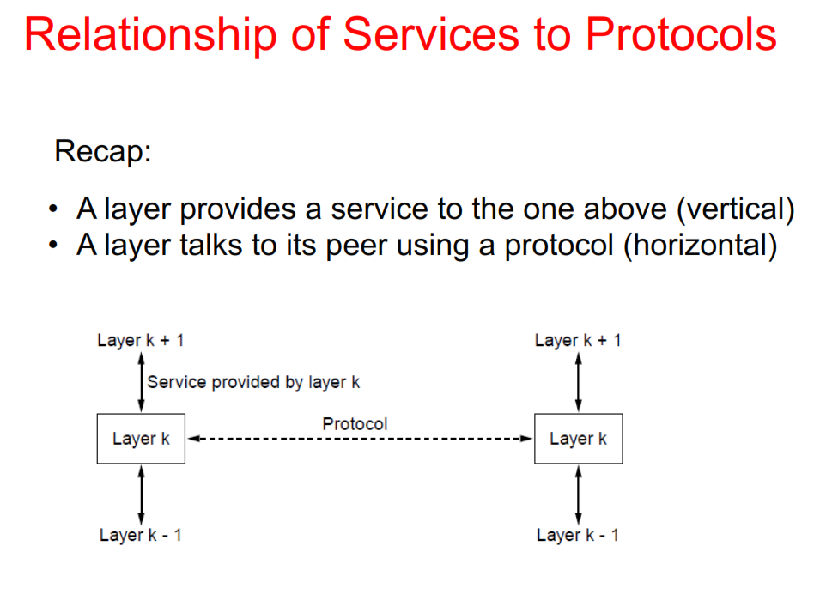
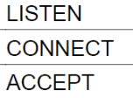
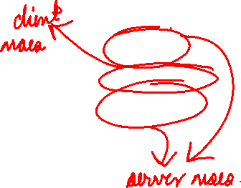

Slide 10
Question:
How is the structure of the Network organized?

Slide 11
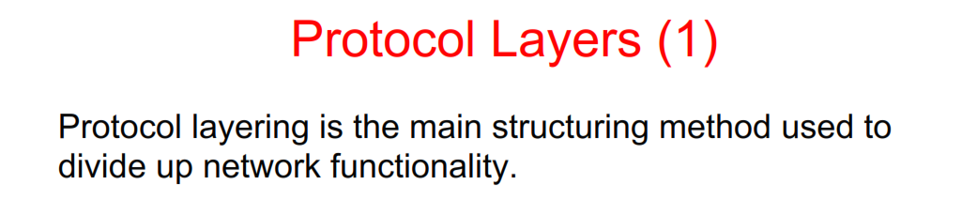
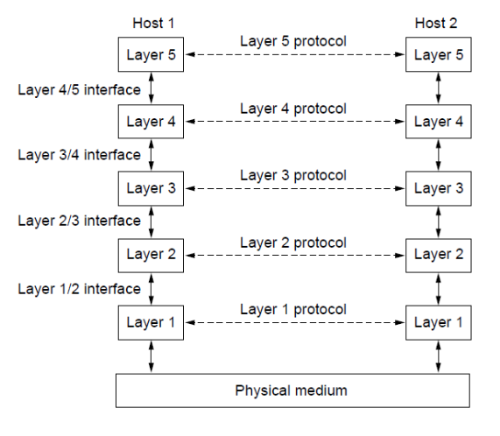
Each protocol instance talks virtually to its peer
Each layer communicates only by using the services below
Lower layer services are accessed by an interface
At bottom, messages are carried by the medium

Slide 12

Internet protocol stack
application: supporting network applications
FTP, SMTP, HTTP
transport: process-process data transfer
TCP, UDP
network: routing of datagrams from source to destination
IP, routing protocols
link: data transfer between neighboring network elements
Ethernet (802.3), WiFi (802.11), PPP
physical: bits “on the wire”
application
transport
network
link
physical

Slide 13
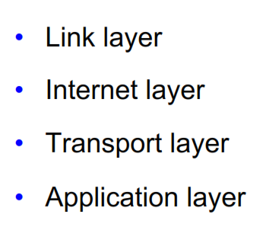
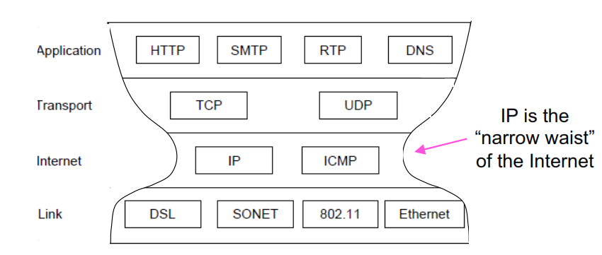
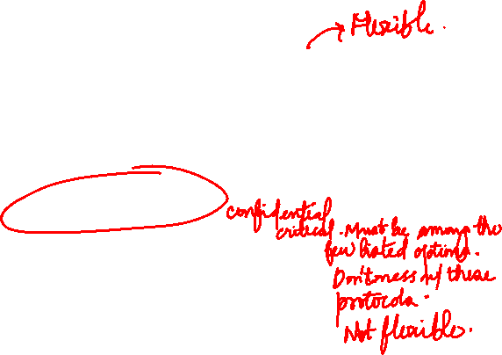
Vint Cerf and Bob Kahn
Kleinrock's "Narrow Waist" Model

Slide 14
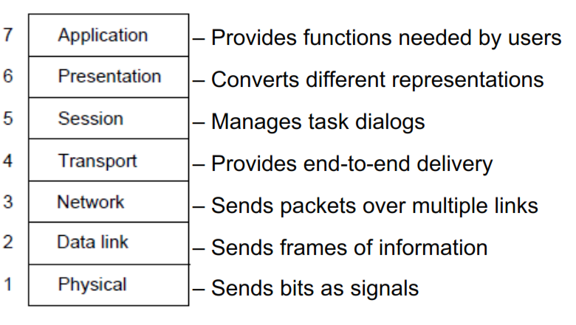

The Open Systems Interconnection (OSI) Reference Model by International Standards Organization (ISO)
Layers created for different abstractions
Each layer performs well-defined function
Function of layer chosen with standards in mind
Minimize information flow across layer interfaces
Find the optimum number of layers

Slide 15

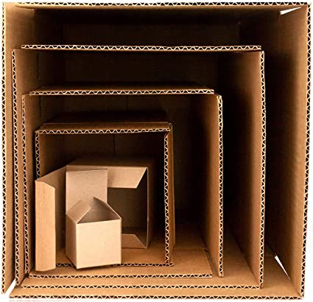
Who is the source (S) computer?
Who is the destination (D) computer?
Who is passing this message to whom?
A gift box example for encapsulating / packing message from S to D

Slide 16
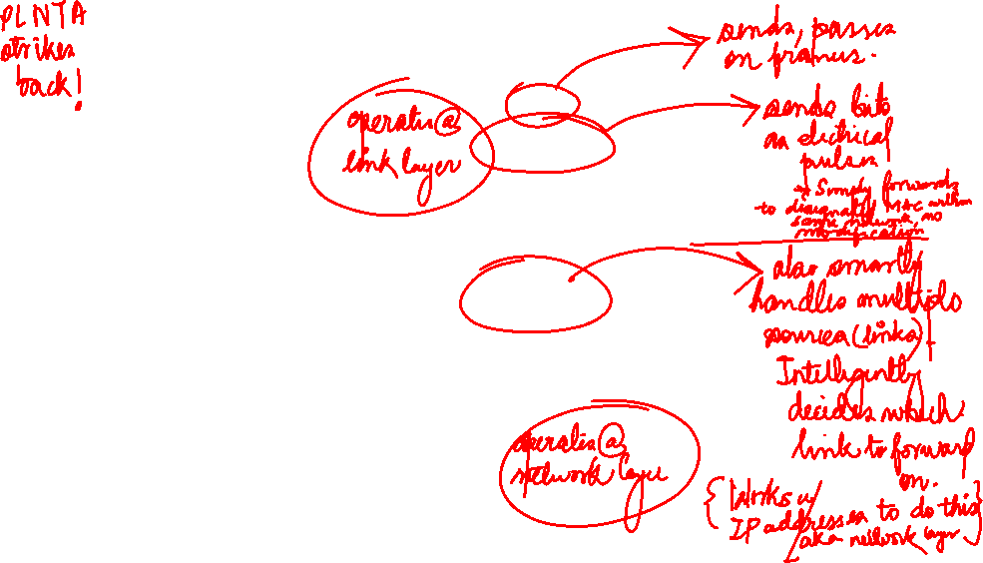
Encapsulation
source
message
M
application
transport
network
link
physical
segment
H_{t}
M
H_{t}
datagram
H_{n}
H_{n}
H_{t}
M
frame
H_{l}
H_{n}
H_{t}
M
link
physical
switch
destination
H_{n}
H_{t}
M
network
link
physical
M
application
transport
network
link
physical
H_{l}
H_{n}
H_{t}
M
H_{n}
H_{t}
M
H_{t}
M
H_{n}
H_{t}
M
H_{l}
H_{n}
H_{t}
M
router

Slide 17
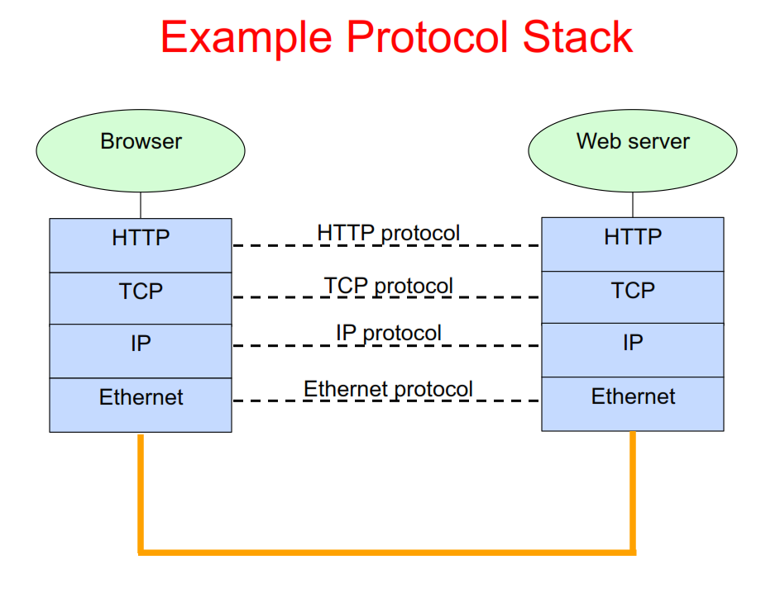

Slide 18
